Slide 1

Realtime Data Processing at Facebook
Guoqiang Jerry Chen, Janet L. Wiener, Shridhar Iyer, Anshul Jaiswal, Ran Lei Nikhil Simha, Wei Wang, Kevin Wilfong, Tim Williamson, and Serhat Yilmaz Facebook, Inc.
Presented By:- Tolulope Olugbenga

Slide 2
Outline
Introduction
Motivation
Requirements of a Realtime Data System
System Architecture
System Overview
Application Example
Design Decisions
Conclusion
Future Work

Slide 3
Introduction
Realtime data processing systems are used widely to provide insights about events as they happen.
Many companies have developed their own systems: examples include Twitter’s Storm and Heron, Google’s Millwheel, and LinkedIn’s Samza.
Realtime Data Processing at Facebook’ provides us with a great high-level overview of the systems Facebook have built to support real-time workloads.
In this paper, the authors introduced Facebook’s Puma, Swift, and Stylus stream processing systems.

Slide 4
Motivation
Facebook runs hundreds of real-time data pipelines in productions.
Realtime data processing powers many use cases at Facebook.
Chorus is a data pipeline to construct the aggregated, anonymized voice of the people on Facebook: What are the top 5 topics being discussed for the election today?
Mobile analytics pipelines provide real-time feedback for Facebook mobile application developers.
Page insights pipelines provide Facebook Page owners real-time information about the likes, reach and engagement for each page post.
The main decision is that a few seconds of latency (with hundreds of Gigabytes per second throughput) meets their performance requirements.

Slide 5
Requirements of a Realtime Data System
Ease of use: How complex are the processing requirements? Is SQL enough? Or is a general-purpose procedural language (such as C++ or Java) essential? How fast can a user write, test, and deploy a new application?
Performance: How much latency is ok? Milliseconds? Seconds? Or minutes? How much throughput is required, per machine and in aggregate?
Fault-tolerance: What kinds of failures are tolerated? What semantics are guaranteed for the number of times that data is processed or output? How does the system store and recover in-memory state?
Scalability: Can data be sharded and resharded to process partitions of it in parallel? How easily can the system adapt to changes in volume, both up and down? Can it reprocess weeks worth of old data?
Correctness: Are ACID (Atomicity, Consistency, Isolation, Durability) guarantees required? Must all data that is sent to an entry point be processed and appear in results at the exit point?

Slide 6
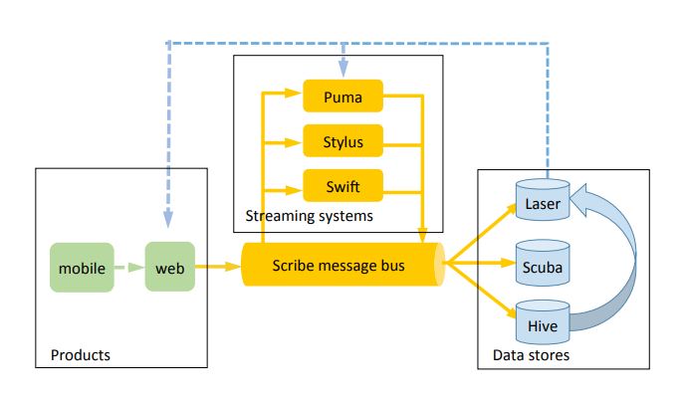
System Architecture
The figure shows an overview of the systems involved in real-time data processing: from logging in mobile and web products on the left, through Scribe and real-time stream processors in the middle, to data stores for analysis on the right.

Slide 7
Systems Overview
Scribe is a persistent, distributed messaging system for collecting, aggregating and delivering high volumes of log data with a few seconds of latency and high throughput. Scribe is the transport mechanism for sending data to both batch and real-time systems at Facebook.
Puma enables stream processing applications to be written in a SQL-like language with Java UDFs. The point of Puma apps is that they are quick to write – “it can take less than an hour to write, test, and deploy a new app.”
Puma provides pre-computed query results for simple aggregation queries
Puma provides filtering and processing of Scribe streams (with a few seconds delay). For example, a Puma application can reduce a stream of all Facebook actions to only posts that match a predicate, such as containing the hashtag “#bigdata”.

Slide 8
Systems Overview
Swift enables stream processing applications to be written in scripting languages (typically Python). It offers a very simple API and also provides checkpointing. Swift is most useful for low-level stateless processing.
Stylus is for heavy-lifting stream applications and supports applications written in C++.
Laser is a high throughput, low latency key-value store built on top of RocksDB. It can read from Scribe categories, and serve data to Laser, Puma, and Stylus apps.
Scuba is an analytics data store, “most commonly used for troubleshooting problems as they happen”. Scuba can ingest millions of rows per second from Scribe, Puma, Stylus, and Swift. It provides ad-hoc querying with response times under 1 second.

Slide 9
Systems Overview
Hive is used as Facebook’s exabyte scale data warehouse:
Facebook generates multiple new petabytes of data per day, about half of which is raw event data ingested from Scribe. (The other half of the data is derived from the raw data, e.g. by daily query pipelines).

Slide 10
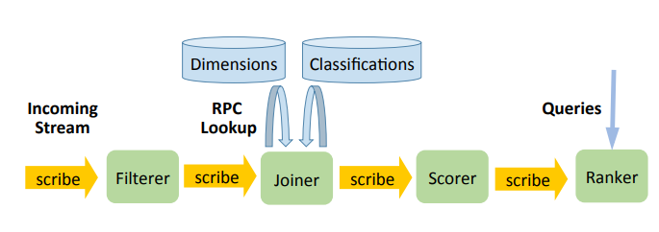
Application Example
The figure shows an example of streaming application with 4 nodes: this application computes “trending” events.
This application identifies trending events in an input stream of events.
The events contain an event type, a dimension id (which is used to fetch dimension information about the event, such as the language in which it is written), and text (which is analyzed to classify the event topic, such as movies or babies). The output of the application is a ranked list of topics (sorted by event count) for each 5 minute time bucket.

Slide 11
Application Example
The Filterer filters the input stream based on the event type and then shards its output on the dimension id
The Joiner queries one or more external systems to retrieve information based on the dimension id and to classify the event by topic, based on its text. The output is then resharded by (event, topic) pair so that the Scorer can aggregate them in parallel.
The Scorer keeps a sliding window of the event counts per topic for recent history. It also keeps track of the long term trends for these counters. Based on the long term trend and the current counts, it computes a score for each (event, topic) pair and emits the score as its output to the Ranker, resharded by topic.
The Ranker computes the top K events for each topic per N minute time bucket.

Slide 12
Design Decisions
How did Facebook end up with this set of systems? The heart of the paper is a collection of five design decisions to be considered when putting together a real-time stream processing system.
What language will people use to write applications for the system? A declarative style (e.g. SQL); a functional style; or a procedural style?
How will data be transferred between nodes? By direct message transfer (e.g. RPC), via a message broker, or by a persistent store acting as intermediary?
What semantics are provided for stream processors? This is broken down into guarantees on input events (at least once, at most once, exactly once) and outputs (at least once, at most once, exactly once).
What mechanism(s) are provided for saving state at stateful processors? Choices include replication, local database persistence, remote database persistence, upstream backups, and globally consistent snapshots.
How is re-processing of old data supported? The choices include stream only replay, the maintenance of separate batch and streaming systems, or developing stream processing systems that can also run in a batch environment.

Slide 13
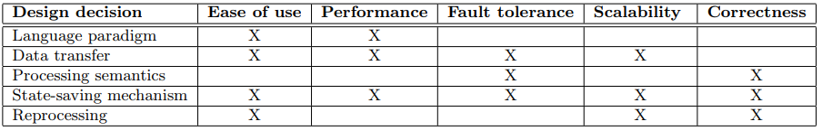
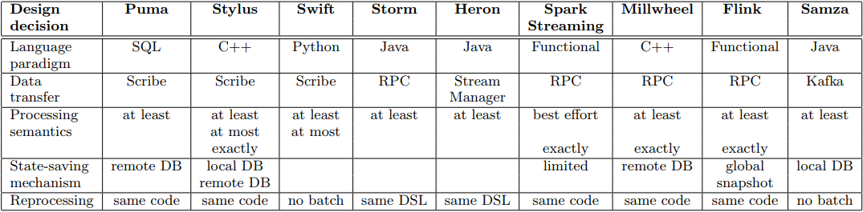
Design Decisions
The figure shows each design decision and how it affects some of the data quality attributes.
The figure shows the design decisions made by different streaming systems.

Slide 14
Conclusion
Having multiple different systems helps Facebook move fast. “Writing a simple application lets our users deploy something quickly and prove its value first, then invest the time in building a more complex and robust application.”
Having the ability to replay streams is a big help when debugging.
Facebook uses alerts to detect when an app is processing its input more slowly than the input is being generated. In the future Facebook plan to scale apps automatically under these conditions.
Streaming versus batch processing does not need to be an either/or decision. Originally, all data warehouse processing at Facebook was batch processing. Using a mix of streaming and batch processing can speed up long pipelines by hours.
Ease of use is as important as the other qualities. In addition to development, making debugging, deployment, and operational monitoring easy has greatly increased the adoption rate of Facebook’s systems.
There is a spectrum of correctness, and not all use cases need ACID (Atomicity, Consistency, Isolation, Durability) semantics.

Slide 15
Future Work
Scaling: improve dynamic load balancing
Alternate environments for stream processing backfill jobs (Spark/Flink vs Hive).

Slide 16
Thank you for your attention!

Slide 17
References
https://research.fb.com/wp-content/uploads/2016/11/realtime_data_processing_at_facebook.pdf (Last Visited: 11-Apr-2019)
https://blog.acolyer.org/2016/07/11/realtime-data-processing-at-facebook/ (Last Visited: 11-Apr-2019)
http://muratbuffalo.blogspot.com/2016/07/realtime-data-processing-at-facebook.html (Last Visited: 11-Apr-2019)
https://samliu.github.io/2016/07/10/realtime-at-facebook.html (Last Visited: 11-Apr-2019)

